Slide 1
Computational Physics (Lecture 4)
PHY4061

Slide 2
Numerical Calculus
the heart of describing physical phenomena.
The velocity and the acceleration of a particle are the first-order and second-order time derivatives of the corresponding position vector…

Slide 3
Numerical differentiation
Taylor exapnsion:
f (x) = f (x0) + (x − x0) f ‘(x0) + (x − x0)²/2! f’’ (x0)+ · ·
The first-order derivative of a single-variable function f (x) around a point x_{i} is defined from the limit
f ‘(x_{i} ) = lim (Δ x→0) [f (x_{i} + Δx) − f (x_{i} )] / Δ x
divide the space into discrete points xi with evenly spaced intervals, h.
f _{i}’= (f_{i+1} − f_{i})/h + O(h).
Can be improved if we expand around i+1 and i-1:
f _{i}’= (f_{i+1} − f_{i-1})/2h+ O(h).

Slide 4
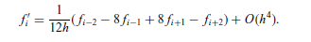
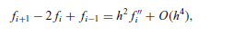
A five point formula:
Obtained by a combination of 4 Taylor series with cutoffs at third order.
f(x+h) = f(x) + hf`(x) + h²f``(x)/2+h³f’’’(x)/6
f(x-h) = f(x) - hf`(x) + h²f``(x)/2-h³f’’’(x)/6
f(x+h) – f(x-h) = 2hf`(x) +h³f’’’(x)/3
Similarly, we have:
f(x+2h) – f(x-2h) = 4hf`(x) +8h³f’’’(x)/3
We can cancle the third order term to obtain the formular.
For a second-order derivative. A three point formula is given by the combination: (Derivation is simple, you can work it out by yourself)

Slide 5
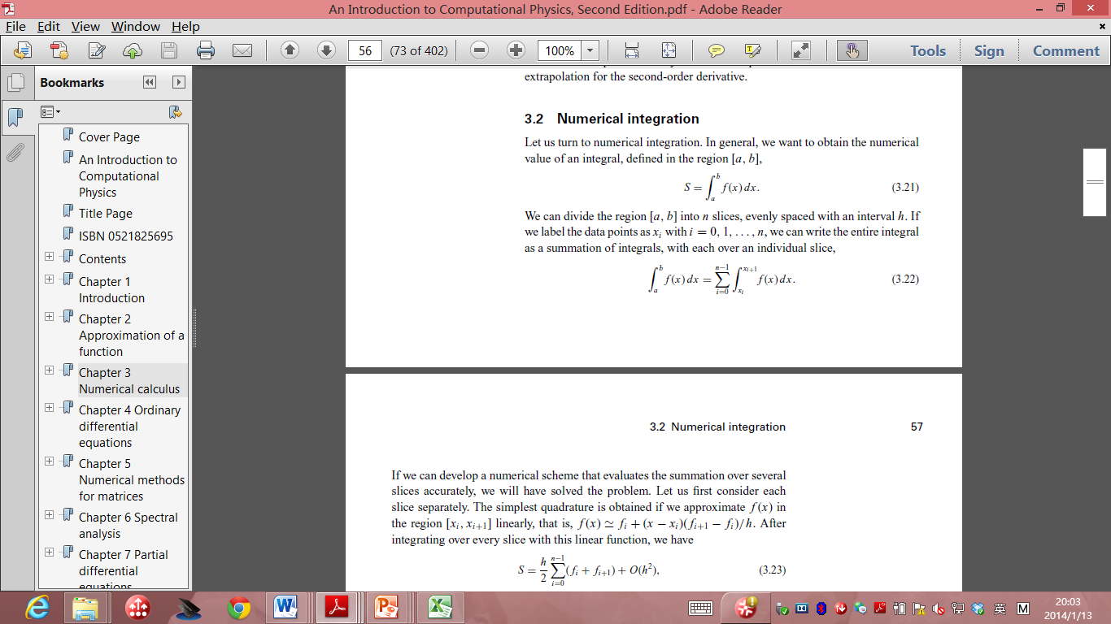
Numerical Integrations
For a integral:
We just divide the region [a,b] into n slices with an interval of h.

Slide 6
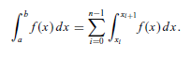
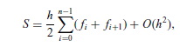
Trapezoid rule
In the standard integration method
To evaluate the integration of each slice, we can approximate the f(x) in the region linearly.
F(x) = fi+(x-x_{i})(f_{i+1}-f_{i})/h
Integrating each slice, we have

Slide 7
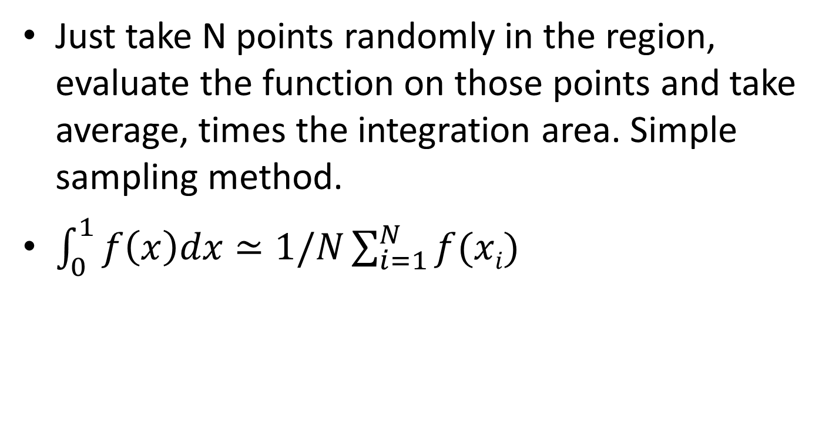
Random method
Just take N points randomly in the region, evaluate the function on those points and take average, times the integration area. Simple sampling method.
$\int_{0}^{1}{f\left(x\right)dx}≃1/N\sum_{i=1}^{N}{f(xi)}$

Slide 8
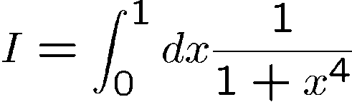







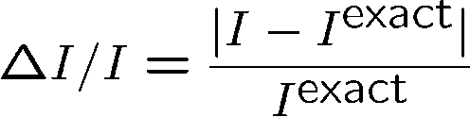
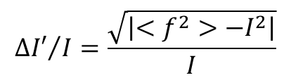
Two Problems:
Calculate: accurate value:
10² | 0.879679 | 1.47x 10⁻² | 1.69 x 10⁻² | 0.1 | 1.69 x 10⁻¹
10³ | 0.871238 | 4.92x 10⁻³ | 5.45 x 10⁻³ | 3.16x 10⁻² | 1.72x 10⁻¹
10⁴ | 0.869603 | 3.03 x 10⁻³ | 1.74 x 10⁻³ | 10⁻² | 1.74 x 10⁻¹
10⁵ | 0.866777 | 2.26 x 10⁻⁴ | 5.61x 10⁻⁴ | 3.16x 10⁻³ | 1.77 x 10⁻¹
10⁶ | 0.866876 | 1.11x 10⁻⁴ | 1.77x 10⁻⁴ | 0.001 | 1.77 x 10⁻¹
10⁷ | 0.867004 | 3.63x 10⁻⁵ | 5.60x 10⁻⁵ | 3.16x 10⁻⁴ | 1.77x10⁻¹
10⁸ | 0.866947 | 2.97x 10⁻⁵ | 1.77x 10⁻⁵ | 10⁻⁴ | 1.77x10⁻¹
10⁹ | 0.866956 | 1.89x 10⁻⁵ | 5.60x 10⁻⁶ | 3.16x 10⁻⁵ | 1.77 x 10⁻¹
$${∆I′}/I=\frac{\sqrt{\left|<f^{2}>−I^{2}\right|}}{I}$$

Slide 9
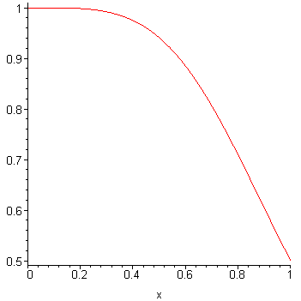
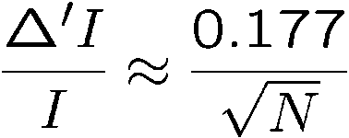
F(x)
Relative error as a function of N

Slide 10
Sample code to illustrate the simple sampling method
// An example of integration with direct Monte Carlo
// scheme with integrand f(x) = x*x.
import java.lang.*;
import java.util.Random;
public class Monte {
public static void main(String argv[]) {
Random r = new Random();
int n = 1000000;
double s0 = 0;
double ds = 0;
for (int i=0; i<n; ++i) {
double x = r.nextDouble();
double f = x*x;
s0 += f;
ds += f*f;
}
s0 /= n;
ds /= n;
ds = Math.sqrt(Math.abs(ds-s0*s0)/n);
System.out.println("S = " + s0 + " +- " + ds);
}
}

Slide 11
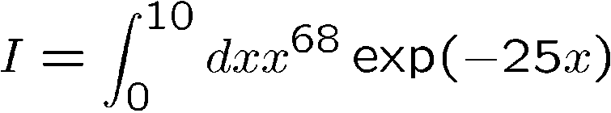
Example 2:
Calculate:
Accurate result:
Using the above method:
10² | 0.52577 | 0.392 | 0.287 | 0.100 | 2.87
10³ | 0.79895 | 0.755x 10⁻¹ | 0.900x 10⁻¹ | 0.316x10⁻¹ | 2.85
10⁴ | 0.88543 | 0.246 x 10⁻¹ | 0.269 x 10⁻¹ | 0.100 x 10⁻¹ | 2.69
10⁵ | 0.87210 | 0.919 x 10⁻² | 0.864x 10⁻² | 0.316x 10⁻² | 2.73
10⁶ | 0.86581 | 0.190x 10⁻² | 0.274x 10⁻² | 0.100x 10⁻² | 2.74
10⁷ | 0.86485 | 0.798x 10⁻³ | 0.868 x 10⁻³ | 0.316 x 10⁻³ | 2.74
10⁸ | 0.86377 | 0.456 x 10⁻³ | 0.275 x 10⁻³ | 0.100 x 10⁻³ | 2.75
10⁹ | 0.86418 | 0.218 x 10⁻⁴ | 0.868 x 10⁻⁴ | 0.316x10⁻⁴ | 2.75
Why it is so bad?

Slide 12
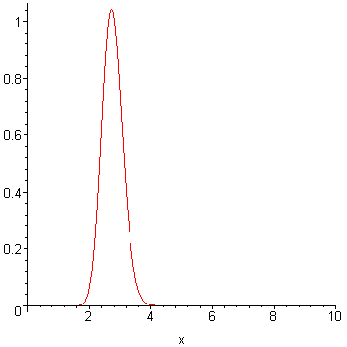
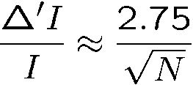
In this example
The function is significant in the range of [2,4]
So it’s no good to eventually divide [0,10]

Slide 13
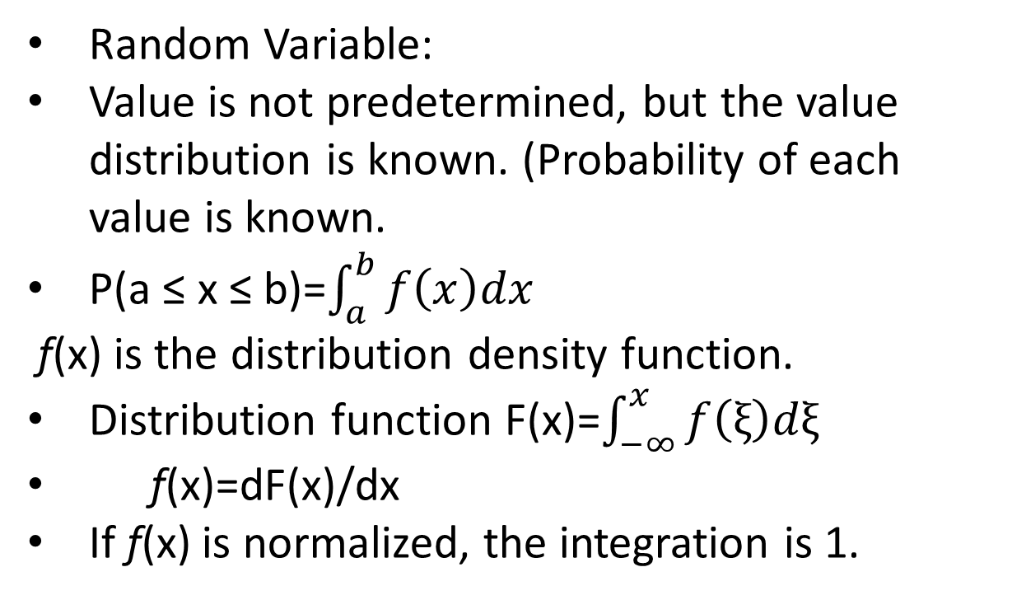
Random Variable, density function and distribution function
Random Variable:
Value is not predetermined, but the value distribution is known. (Probability of each value is known.
P(a ≤ x ≤ b)=$\int_{a}^{b}{f\left(x\right)dx}$
f(x) is the distribution density function.
Distribution function F(x)=$\int_{−∞}^{x}{f\left(ξ\right)dξ}$
f(x)=dF(x)/dx
If f(x) is normalized, the integration is 1.

Slide 14
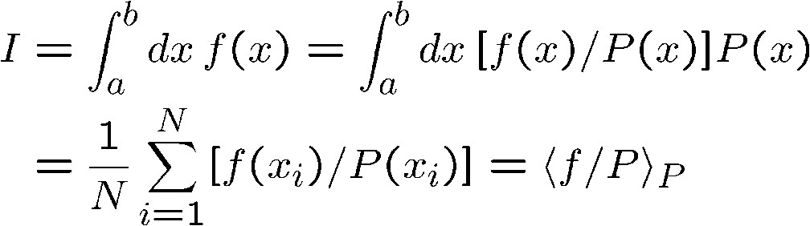

Calculate it intelligently:
Importance sampling:
Take some distribution function P(x). (normalized). The integration is now:
If we take, σ is zero!! Of course,
we don’t know I….
However, we know the shape of f(x). Therefore, we still can construct a P(x), to reduce the error.

Slide 15











Consider this algorithm: construct a series of random numbers:
1, Randomly pick:
2, Suppose, for each ;
a random number in
: adjustable parameter. evaluate
If let
If generate another random number:
If let Otherwise,

Slide 16

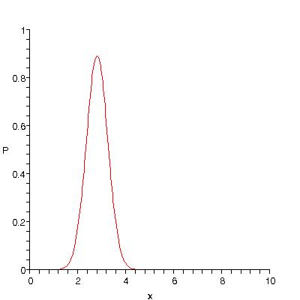


With { }, Recalculate the problem.

Slide 17
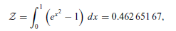
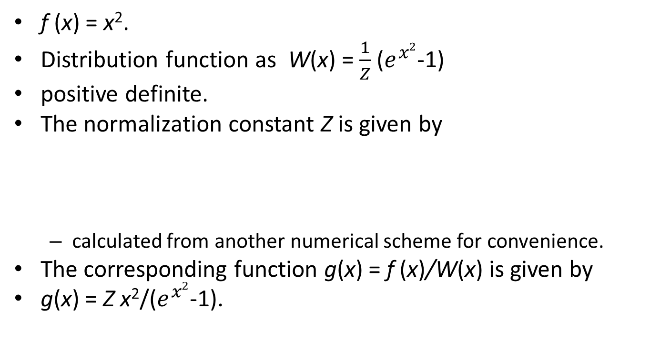
Code for Importance sampling(Metropolis algorithm)
f (x) = x².
Distribution function as W(x) = $\frac{1}{Z}$ ($e^{x2}$-1)
positive definite.
The normalization constant Z is given by
calculated from another numerical scheme for convenience.
The corresponding function g(x) = f (x)/W(x) is given by
g(x) = Z x²/($e^{x2}$-1).

Slide 18
// An example of Monte Carlo simulation with the
// Metropolis scheme with integrand f(x) = x*x.
import java.lang.*;
import java.util.Random;
public class Carlo {
static final int nsize = 10000;
static final int nskip = 15;
static final int ntotal = nsize*nskip;
static final int neq = 10000;
static int iaccept = 0;
static double x, w, h = 0.4, z = 0.46265167;
static Random r = new Random();
public static void main(String argv[]) {
x = r.nextDouble();
w = weight();
for (int i=0; i<neq; ++i) metropolis();
double s0 = 0;
double ds = 0;
iaccept = 0;
for (int i=0; i<ntotal; ++i) {
metropolis();
if (i%nskip == 0) {
double f = g(x);
s0 += f;
ds += f*f;
}
}
s0 /= nsize;
ds /= nsize;
ds = Math.sqrt(Math.abs(ds-s0*s0)/nsize);
s0 *= z;
ds *= z;
double accept = 100.0*iaccept/(ntotal);
System.out.println("S = " + s0 + " +- " + ds);
System.out.println("Accept rate = " + accept + "%");
}

Slide 19
public static void metropolis() {
double xold = x;
x = x + 2*h*(r.nextDouble()-0.5);
if ((x<0) || (x>1)) x = xold;
else {
double wnew = weight();
if (wnew > w*r.nextDouble()) {
w = wnew;
++iaccept;
}
else x = xold;
}
}
public static double weight() {
return Math.exp(x*x) - 1;
}
public static double g(double y) {
return y*y/(Math.exp(y*y)-1);
}
}

Slide 20
The step size is adjustable
keep it such that the accepting rate of the new configurations is less than or around 50%
such a choice of accepting rate is compatible with considerations of speed and accuracy.
we can easily modify it to study other problems.
In practice how do we decide the step size when we run the code?

Slide 21
Performance of the random sampling method
Bad, really bad, error is proportional to N^{-1/2}
Trapezoid rule, error is proportional to N⁻²
Advantage in multi-dimensional integrals!
Suppose we have a many body system, for example 10 particles, then we have 30 dimensions!
For random sampling method, error is just proportional to N^{-1/2}
For trapezoid rule, it is proportional to N^{-2/d}!
Suppose we have 10²³ particles!

Slide 22
Roots of an equation
Find the possible value of x that ensures the equation f (x) = 0
If such a value exists, we call it a root or zero of the equation.
Discuss only single-variable problems
The discussion of multivariable cases will be discussed later in matrix operations.

Slide 23
Bisection method
If we know that there is one root x = x_{r} in the region [a, b] for f (x) = 0,
the bisection method to find it within a required accuracy.
Very intuitive and simple method.
Because there is a root in the region, f (a) f (b) < 0.
divide the region into two equal parts with x₀ = (a + b)/2.
Then we have either f (a) f (x0) < 0 or f (x0) f (b) < 0.
If f (a) f (x0) < 0, the next trial value is x1 = (a + x0)/2;
otherwise, x1 = (x0 + b)/2. This procedure is repeated until the improvement on x_{k} or | f (x_{k} )| is less than the given tolerance δ.

Slide 24
One example
f (x) = e^{x} ln x − x²
when x = 1, f (x) = −1
when x = 2, f (x) = e² ln 2 − 4 ≈ 1.
At least one value x_{r} ∈ [1, 2] that would make
f (x_{r}) = 0.
In the neighborhood of x_{r}, we have f (xr + δ) > 0 and f (xr − δ) < 0.

Slide 25
Sample code
// An example of searching for a root via the bisection
// method for f(x)=exp(x)*ln(x)-x*x=0.
import java.lang.*;
public class Bisect {
public static void main(String argv[]) {
double x = 0, del = 1e-6, a = 1, b = 2;
double dx = b-a;
int k = 0;
while (Math.abs(dx) > del) {
x = (a+b)/2;
if ((f(a)*f(x)) < 0) {
b = x;
dx = b-a;
}
else {
a = x;
dx = b-a;
}
k++;
}
System.out.println("Iteration number: " + k);
System.out.println("Root obtained: " + x);
System.out.println("Estimated error: " + dx);
}
// Method to provide function f(x)=exp(x)*log(x)-x*x.
public static double f(double x) {
return Math.exp(x)*Math.log(x)-x*x;
}
}

Slide 26
The Newton method
Based on linear approximation of a smooth function around its root.
Taylor expansion near the root x_{r} :
f (x_{r}) ≃ f (x) + (x_{r} − x) f ‘(x)+· · · = 0
x: a trial value for the root of x_{r} at the kth step and the approximate value of the next step x_{k+1} can be derived from
f (x_{k+1}) = f (x_{k} ) + (x_{k+1} − x_{k} ) f’ (x_{k} ) ≃0
Therefore,
x_{k+1} = x_{k} + Δx_{k} = x_{k} − f_{k}/ f_{k}‘
k = 0, 1, . . . .
Here f_{k} = f (x_{k} ).
The above iterative scheme is known as the Newton method or Newton–Raphson method.

Slide 27
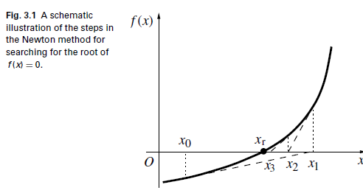
The above equation is equivalent to approximating the root by drawing a tangent to the curve at the point x_{k} and taking x_{k+1} as the tangent’s intercept on the x axis.

Slide 28
// An example of searching for a root via the Newton method
// for f(x)=exp(x)*ln(x)-x*x=0.
import java.lang.*;
public class Newton {
public static void main(String argv[]) {
double del = 1e-6, a = 1, b = 2;
double dx = b-a, x=(a+b)/2;
int k = 0;
while (Math.abs(dx) > del) {
dx = f(x)/d(x);
x -= dx;
k++;
}
System.out.println("Iteration number: " + k);
System.out.println("Root obtained: " + x);
System.out.println("Estimated error: " + dx);
}
public static double f(double x) {...}
// Method to provide the derivative f'(x).
public static double d(double x) {
return Math.exp(x)*(Math.log(x)+1/x)-2*x;
}
}

Slide 29
Discussions
The root = 1.694 600 92 after only five iterations!
more efficient
The error is much smaller
even though we have started the search at the same point
a much smaller number of steps.
Each newstep size in the Newton method is determined by the ratio of the value and the slope of the function f (x) at x_{k}.
For the same function value, a large step is created for the small-slope case
a small step is made for the large-slope case. This ensures an efficient update and
Important to understand this algorithm to finish PROJ A.
Problem:
We may not know the form of the derivative

Slide 30
Secant method
Very simple improvement.
Just replace F’ with a two point formula for the first order derivative.
x_{k+1} = x_{k} − (x_{k} − x_{k−1}) f_{k}/( f_{k} − f_{k-1}).
Known as secant method or discrete Newton method.
Disadvantage:
Need two points to start.
Advantage:
Don’t need to have the knowledge of the first derivative!

Slide 31
// An example of searching for a root via the secant method
// for f(x)=exp(x)*ln(x)-x*x=0.
import java.lang.*;
public class Root {
public static void main(String argv[]) {
double del = 1e-6, a = 1, b = 2;
double dx = (b-a)/10, x = (a+b)/2;
int n = 6;
x = secant(n, del, x, dx);
System.out.println("Root obtained: " + x);
}
// Method to carry out the secant search.
public static double secant(int n, double del,
double x, double dx) {
int k = 0;
double x1 = x+dx;
while ((Math.abs(dx)>del) && (k<n)) {
double d = f(x1)-f(x);
double x2 = x1-f(x1)*(x1-x)/d;
x = x1;
x1 = x2;
dx = x1-x;
k++;
}
if (k==n) System.out.println("Convergence not" +
" found after " + n + " iterations");
return x1;
}
public static double f(double x) {...}
}

Slide 32
How to program a reciprocal lattice?

Slide 33


How to program a reciprocal lattice
b₁=2π (a₂ x a₃) / Ω Ω = a_{1 ·}(a₂ х a₃) volume of the unit cell
b₂=2π (a₃ x a₁) / Ω
b₃=2π (a₁ x a₂) / Ω
So here, suppose we know a1, a2 and a3 vectors in the real space. (for each ai, we just store the Cartesian coordinates in an array, a1(), a2() and a3().
All we need to calculate is the volume of the unit cell and the cross product of two unit vectors.
These two tasks are very easy and straight forward.

Slide 34
Periodic boundary condition
In simulations, we can only calculate a relatively small unit-cell (super cell) comparing with the infinite lattice.
We can apply periodic boundary condition to simulate the infinite lattice.
More or less like a video game.
How to calculate the distance of two points in a unit cell applied with a periodic boundary condition?

Slide 35
Fractional coordinates
In crystallography, a fractional coordinate system is a coordinate system in which the edges of the unit cell are used as the basic vectors to describe the positions of atomic nuclei.
Suppose we have an atom at t(x1, y1, z1). The basis vectors for the unit cell is a1, a2 and a3 and the basis vectors for the reciprocal cell is b1, b2 and b3.

Slide 36
t = n₁a₁+n₂a₂+n₃a₃ (n₁, n₂ and n₃ are fractional numbers)
t ∙ b₁=n₁a₁ ∙ b₁=2n₁π,
t ∙ b₂=n₂a₂ ∙ b₂=2n₂ π
t ∙ b₃=n₃a₃ ∙ b₃=2n₃ π
Therefore, n_{i}=t ∙ b_{i} (i=1,2,3) (in unit of 2 π)
Then we take mod (n_{i,} ,1.0) (the number is now from 0 to 1.0)
Not only atomic position, we can also use fractional coordinates to describe inter-atomic distance.

Slide 37
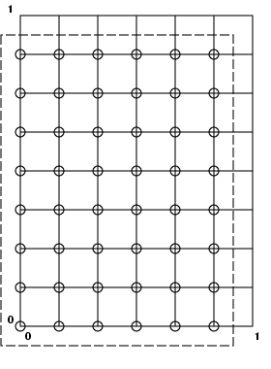
a2
a1

Slide 38
PBC for distance of atoms
Suppose (x1, y1, z1) is the distance of two atoms. We can also apply PBC to help us to check the neighbor list in the future.
From the fractional coordinates, simply shift the allowed range 0.5 to the left. We make it from (-0.5, 0.5) and return n1, n2, n3 and (x2,y2,z2) in Cartesian coordinates.
How do we shift 0.5?
These (x2,y2,z2) are the minimum distance of two atoms with PBC applied.

Slide 39
Neighbor lists
After the set up of a unitcell,
We can just keep the list of neighbor atoms.
The key is to calculate the distance of atoms with the periodic boundary condition applied.
x1=rv(1,i)-rv(1,j)
y1=rv(2,i)-rv(2,j)
z1=rv(3,i)-rv(3,j)
call pbc(x1,y1,z1,x2,y2,z2)
dist=x2*x2+y2*y2+z2*z2
Then we compare the dist with rc. If the dist < rc, we store the coordinates in an array of the neighbor list of ith atom.

Slide 40
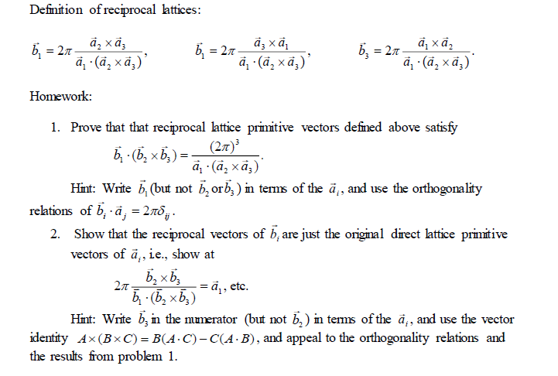

Slide 41
3, Show the packing fraction in the following crystal structures: bcc = (√3/8)pi, fcc = (√ 2/6)pi, and Diamond=(√ 3/16)pi.
4, write a small program to integrate f(x) = x⁶ from [-1, +1] using trapezoidal rule and random sampling. Calculate the squared deviation from the true value as a function of M sample points or N slices and compare the difference of these two algorithms.
Submit your HW solution, code, and a brief report of problem 4 to our TA. Due in two weeks.

Slide 42
Project A Part II
1 calculate a reciprocal lattice vectors b1, b2 and b3 from the lattice vectors of a1, a2 and a3 (unit cell) in real space, calculate and return the volume of the unit cell.
Store the x, y, z coordinates of ai and bi in arrays.
Test SC, BCC, FCC to make sure the code is correct. Note that the reciprocal lattice vectors for primitive cell of BCC is FCC and vice versa.
2 input a coordinate (x1, y1, z1) with (a1,a2,a3) as the unit cell, apply periodic boundary conditions, return the fractional coordinates n1, n2, n3 (in the range of (-0.5, 0.5) and the (x2, y2, z2)
Hint, call the code of reciprocal to have (b1,b2,b3) ready, then take the dot product and mod.

Slide 43
3 Neighbor list
Input a1, a2 and a3 vectors, atomic positions in the unit cell, distance cutoff.
Calculate the neighbor list of each atom, the distance from the neighbor to each atoms.
Hint, use reciprocal and pbc code to store all the information into neighbor list arrays and distance arrays.
Check the case of simple cubic, FCC and BCC.
Hint: make sure the cutoff is correct for nearest neighbors.
Due in two weeks after the lab of part II.

